Slide 1
Docker
4 New users
Docker 4 New users :: Rodislav MOLDOVAN and Others

Slide 2
How many package formats you prefer ?
1 universal
N different
OR
N > 1
Docker 4 New users :: Rodislav MOLDOVAN and Others

Slide 3
Assumptions
You want to learn stuff
You love to practice
You just had another coffee
You love Linux
Rodi will talk the talk
Docker 4 New users :: Rodislav MOLDOVAN and Others

Slide 4

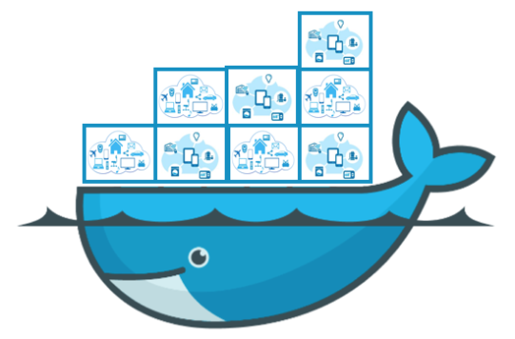





Where we use docker
Dev machines
For third party dependencies we use docker-compose
Sometimes Minikube
CI environments for tests
For tests, integration and/or bdd
Deliver docker images only, no jar/war/ear artifacts
Provision dependency infrastructure: elastic, mongodb, sql db, kibana
+
+
+
+
Docker 4 New users :: Rodislav MOLDOVAN and Others

Slide 5
Where we use docker
Staging and Production
Only helm charts and kubernetes
Artifactory is used as a registry for docker images
+
+
+
Docker 4 New users :: Rodislav MOLDOVAN and Others

Slide 6
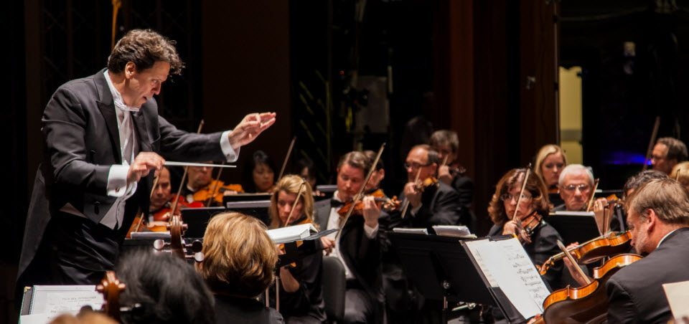
Kubernetes

Slide 7
Helm
Package manager for kubernetes
Equivalent of
sudo apt-get install mysql
brew install mysql
npm install expressjs
But for Kubernetes

Slide 8
Artifactory
Artifact storage for various formats
Maven, npm, docker, etc.
Can work as registry for docker images
It’s something like google drive, dropbox but for applications
Supports versions for each type of format

Slide 9
Docker
Docker is a tool designed to make it easier to create, deploy, and run applications by using containers. https://opensource.com/resources/what-docker
Dockerfiles
Packaging
Images
Containers
Docker 4 New users :: Rodislav MOLDOVAN and Others

Slide 10
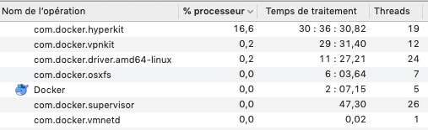
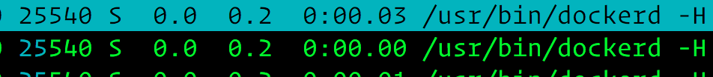
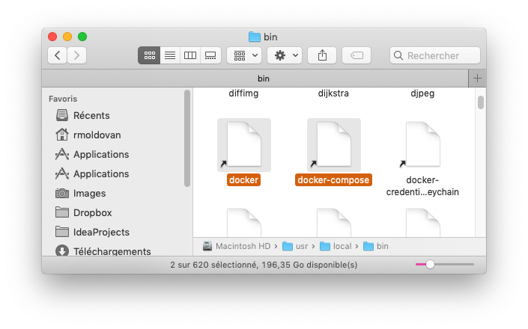
Docker – main parts
Docker has a daemon / process
dockerd – Daemon CLI
And a client that can talk to the daemon
docker - Docker CLI
The communication can be done via 3 different types of sockets:
unix
tcp
fd
Docker 4 New users :: Rodislav MOLDOVAN and Others

Slide 11
Docker – typical scenario
We write a: Dockerfile
We build the image: docker build .
We run containers: docker run mysql
Docker 4 New users :: Rodislav MOLDOVAN and Others

Slide 12
Dockerfiles
An actual file called: Dockerfile
Contains the instructions needed to the image
Each line of the Dockerfile starts with a docker command
Has one of the folowing docker commands: ENTRYPOINT or CMD, who tell how to start the application
https://www.pinterest.com/pin/811633164069888065/
Docker 4 New users :: Rodislav MOLDOVAN and Others

Slide 13
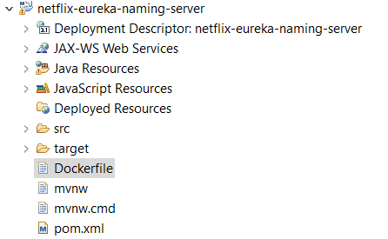
Dockerfiles – example
Dockerfile
FROM ubuntu:18.04
COPY . /app
RUN make /app
CMD python /app/app.py
https://dzone.com/articles/dockerizing-the-eureka-server-and-spring-boot-appl
Docker 4 New users :: Rodislav MOLDOVAN and Others

Slide 14
CMD vs ENTRYPOINT
CMD instruction allows you to set a default command, which will be executed only when you run container without specifying a command. If Docker container runs with a command, the default command will be ignored. If Dockerfile has more than one CMD instruction, all but last CMD instructions are ignored.
ENTRYPOINT instruction allows you to configure a container that will run as an executable. It looks similar to CMD, because it also allows you to specify a command with parameters. The difference is ENTRYPOINT command and parameters are not ignored when Docker container runs with command line parameters. (There is a way to ignore ENTTRYPOINT, but it is unlikely that you will do it.)

Slide 15
Images
Images are .tgz archives
Called layers
Which contains files of your applications
We have one layer per Dockerfile command
Docker 4 New users :: Rodislav MOLDOVAN and Others

Slide 16
Images
TLDR; Layers of a Docker image are essentially just files generated from running some command. You can view the contents of each layer on the Docker host at /var/lib/docker/aufs/diff.
Layers are neat because they can be re-used by multiple images saving disk space and reducing time to build images while maintaining their integrity.
https://medium.com/@jessgreb01/digging-into-docker-layers-c22f948ed612
Docker 4 New users :: Rodislav MOLDOVAN and Others

Slide 17
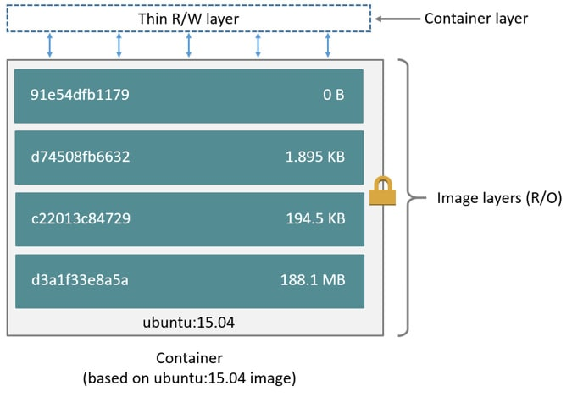
Images
Each image is a .tgz archive
docker image inspect 7d83a47ab2d2
7d83a47ab2d2 is id of an image from my machine.
Try docker images on your machine and use one of the ids
https://blog.mornati.net/docker-images-and-chown/
Docker 4 New users :: Rodislav MOLDOVAN and Others

Slide 18
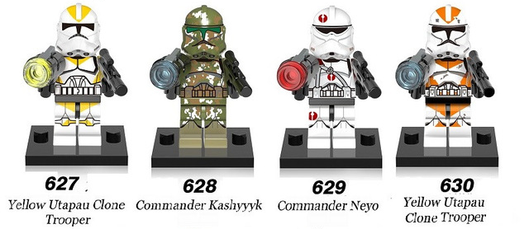
Containers
Containers are parameterized instances of images
Just like we can have multiple windows of the same application: in the same way we can have multiple containers of the same image.
docker run mysql:tag
https://fr.aliexpress.com/item/Star-Wars-Wolf-Pack-Yellow-Utapau-Clone-Trooper-Commander-Kashyyyk-Gree-Building-Blocks-Best-Education-Toys/32807818041.html
Docker 4 New users :: Rodislav MOLDOVAN and Others

Slide 19
Containers
Containers can run 1 single process at a time
Each process inside a container has it’s own namespace at OS kernel level
Persistent storage, user space, network, etc.
Because of that, each container has it’s « own localhost, own files, etc. »
You cannot have 1 container with Nginx+PHP and MySQL to run a wordpress instance.
But you can have 2 containers
Nginx + PHP
MySQL
Docker 4 New users :: Rodislav MOLDOVAN and Others

Slide 20
Containers
If the process inside the container will crash the container will be stopped

Slide 21


Docker – big picture
Host (a physical or virtual machine)
localhost
8080
7079
80
443
docker run –p 8080:8080 ..
docker run –p 7079:8080 ..
docker run -v /media/app1:/var/www
Container 1
Container 2
localhost
8080
80
443
localhost
8080
80
443
/media/app1
/….
/usr/local
/var/www
/media/app2
/home/app/data
docker run -v /media/app2:/home/app/data

Slide 22
Docker – inter-container communication
Host (a physical or virtual machine)
virtual network – managed by docker-compose
Uses service names to resolve
my-app = Container 1
redis = Container 2
docker-compose.yml
version: '3’
services:
my-app:
image: "accounting:latest"
redis:
image: "redis:alpine"
my-app and redis are service names
Container 1
Container 2
localhost
8080
80
443
localhost
8080
80
443
/var/www
/home/app/data

Slide 23
Summary
Docker is not a virtual machine manager
Forget about VMs for now.
Docker can build images with the help of Dockerfiles
Containers are instances of images
Again - One container can have only one process
Docker 4 New users :: Rodislav MOLDOVAN and Others

Slide 24
Tools
Docker binary, that runs in any terminal
docker-compose, can run a bunch of containers and add some super powers
Kitematic, a visual, Virtualbox like user interface
Docker integration for Intellij Idea
Portainer, web app that can talk to docker
Maven / Gradle plugins
Docker 4 New users :: Rodislav MOLDOVAN and Others

Slide 25
Host platforms
Docker runs primarily on Linux
Since Linux is Bio, Green, Natural and soo
Has a windows version with a windows kernel
This is true, Santa Klaus exists and it is containerized
As well via virtual machine like HyperV or VirtualBox
In macOS it can run via HyperKit by using a small Linux kernel
https://giphy.com/gifs/awww-NePmOWJ76pZ8A
Docker 4 New users :: Rodislav MOLDOVAN and Others

Slide 26
Future of docker
Micro VMs
There’s a lot of fuzz around Micro VMs, a replacement for docker and containers in general.
Will it kill or not the containers ? We do not know yet But let’s wait for the season finale
Docker 4 New users :: Rodislav MOLDOVAN and Others

Slide 27
Code together
Let’s hello world together
Let’s fail building images and be happy about it
In other words: is anti demo time – because we’ll do it together!
https://git.pictet.io/users/rmoldovan/repos/docker-for-beginners
Docker 4 New users :: Rodislav MOLDOVAN and Others

Slide 28

Docker 4 PTL users :: Rodislav MOLDOVAN and Others

Slide 29
Comments
Je te propose de rester sur les métaphores classiques de docker, la comparaison avec Aria est tirée par les cheveux et ne fait pas avancer le talk. Idem pour le sac j’ai trouvé ça long, là ou l’analogie du transport maritime est straight to the point.
Tu annonces un dev together, je n’ai pas l’impression qu’on l’est vraiment fait. Je te propose de créer un petit repos git avec des Dockerfile pour simplifier cette partie code et avoir divers exemples avec différent type d’image classique (tomcat, mysql, ...)
J’ai eu des fois l’impression que les sujets étaient traités trop rapidement et trop superficiellement. Par exemple sur le entrypoint tu dis qu’on peut le surcharger, mais tu expliques pas à quoi ça sert, pourquoi on peut/doit le surcharger, et comment on peut le faire.
J’ai bien aimé la partie sur les layers
Je te propose d’expliquer les commandes classiques, conment on fait un build, un run, comment voir les logs, se connecter à un container etc
Je te propose aussi de faire un petit schéma global d’une machine qui ferait tourner des containers, pour mieux comprendre les volumes, les ports et les interactions entre les différents container
Je n’ai pas eut l’impression que la question du jeu était en rapport avec le talk, je te propose de la retirer ou de la changer pour qu’elle est plus de sens
I did not understood what is kubernetes
Briefly explain used things in the talk – kube, artifactory, others.

